Slide 1
“…By this everyone will know that you are my disciples, if you love one another.” John 13:35
🔑 Message Series -
OVERALL QUESTION: What does Love “LOOK” like from the outside?
How will someone see that you “love one another”?
Today - # 3: Mature Love
Colossians 3 / Ephesians 4
👉 Get your Journal out or you phone to take notes!

Slide 2
Opening Prayer
Take us on a journey
Open our ears and hearts
Stop us from being offended
Convict us to align with you
Help us to grow!
Expand your kingdom, thy will be done!

Slide 3
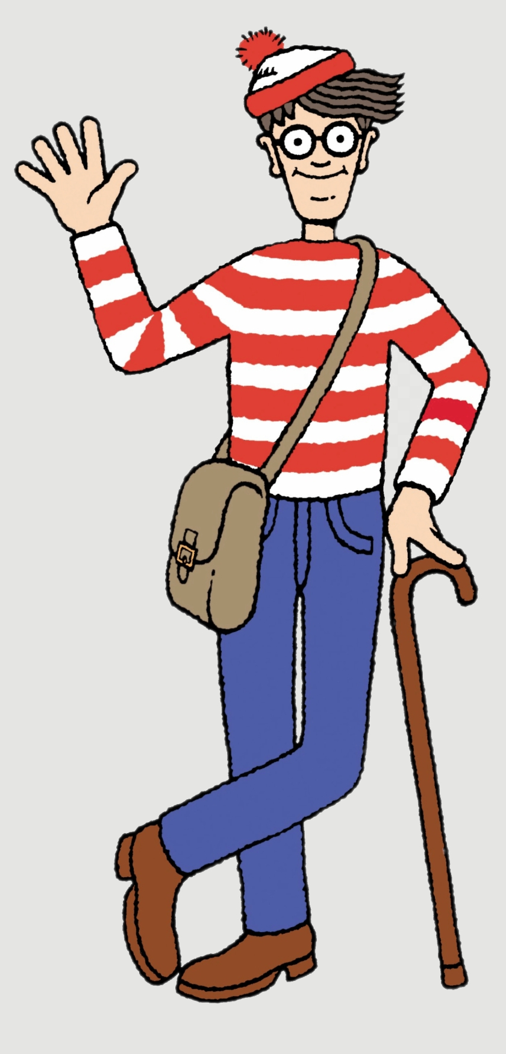
Every message in the Series will land the same way
Gospel, application, accountability.
A reference to Jesus and His good news
One clear practical application
One action to take this week
One person to share it with that was not here today
One close friend to spur you on and support each other in this task
Each will only help you grow stronger – no condemnation intended. (If you are struggling let me know.)
But… get comfortable with being uncomfortable
Love One Another | Forgiveness and Bearing with| Col 3/Eph 4

Slide 4
Review Previous Messages
Who can remember what they were about?
🐘

Slide 5
Review: Message 1 – Speech Message 2 – Loads and Burdens
Speech is a 2-Sided Coin: Heads - Build people up, Tails - Tame the tongue, stop gossip.
Every word you speak is either building the ‘Church’... Or burning it down. (Eph 4/James 3)
“Don’t do for someone what God is expecting them to do! But always help with what they cannot do alone.” (Gal 6)
Love One Another | Forgiveness and Bearing with| Col 3/Eph 4

Slide 6
Something Beautiful is Happening!!!…
We were going to preach: Week 3 - “Serve One Another” Acts 2-4
But many of you… are just doing it!
People stepping in Helping quietly Checking on each other with
Practical care
  Meals
  Furniture
  Repairs
  Transport
  Support
  Encouragement
  Prayer
👉 That is what healthy love looks like Keep it up – OUT DO EACH OTHER -- “By this everyone will know…”
Love One Another | Forgiveness and Bearing with| Col 3/Eph 4

Slide 7
Today: We Must Have Mature Love
One truth – One coin with two sides
The Three Coins
(In your small groups go over this again
SOS: Say Obey Share & Use Your Coin)
7
Love One Another | Forgiveness and Bearing with| Col 3/Eph 4

Slide 8
Forgiveness & Bearing With One Another
Colossians 3:12–14
Ephesians 4:31–32
“Love does not keep score.
Love absorbs cost.
Love chooses to preserve the relationship.”

Slide 9
Colossians 3:12-14
¹² Put on then, as God's chosen ones, holy and beloved, compassionate hearts, kindness, humility, meekness, and patience, ¹³ bearing with one another and, if one has a complaint against another, forgiving each other; as the Lord has forgiven you, so you also must forgive. ¹⁴ And above all these put on love, which binds everything together in perfect harmony.

Slide 10
Ephesians 4:31–32
³¹ Let all bitterness and wrath and anger and clamor and slander be put away from you, along with all malice. ³² Be kind to one another, tenderhearted, forgiving one another, as God in Christ forgave you.

Slide 11
Mature Love - One Coin - with Two Commands
Heads - Command 1
Tails - Command 2
Forgive Each Other
(Release / Cancel Debt / Reconciliation, Let Go)
But… Some people “forgive” but walk away from the relationship as the easy way out.
Bear With Each Other
(Patience / Endurance / Long-suffering)
But Warning… You can put up with someone without forgiving them!
Only together do they form mature love.
The Holy Spirit can help you pursue reconciliation where possible.

Slide 12
Heads: To Bear with One Another
Endures (Put up with) their weakness
Stays relational
Opens up conversation not shut it down
Helps them to grow in Christ
Model Assist Watch and Launch is discipleship. (MAWL)
First model what you want them to do!
Don’t quit quickly
Make room for immaturity
Remain patient
Bearing with weakness is not the same as tolerating ongoing destructive sin

Slide 13
Tails: Forgive One Another
Graciously Release debt
Refuse scorekeeping
Absorb cost
Cancel revenge
Let bitterness die. (It’s a pill that will only kill you.)
Forgiveness is an ongoing choice not a feeling or eliminating the problem by walking away!
👉 “Love absorbs the cost instead of keeping score.”

Slide 14
Best Example: Good News of Jesus Christ
For all have sinned and fallen short of the glory of God. (Rom 3:23)
For the wages of sin is death, but the free gift of God is eternal life in Christ Jesus our Lord. (Rom 6:23)
…but God shows his love for us in that while we were still sinners, Christ died for us. (Rom 5:8)
Here’s the catch….
Col 3:12 & Eph 4:32
“As the Lord forgave you, so you also must forgive!”

Slide 15
You offended God infinitely more than anyone has offended you.
Yet Christ:
  Moved toward you
  Absorbed your debt
  Paid your cost
  Offered a way back to God (reconciliation)
👉 The cross is forgiveness with nails in it.

Slide 16
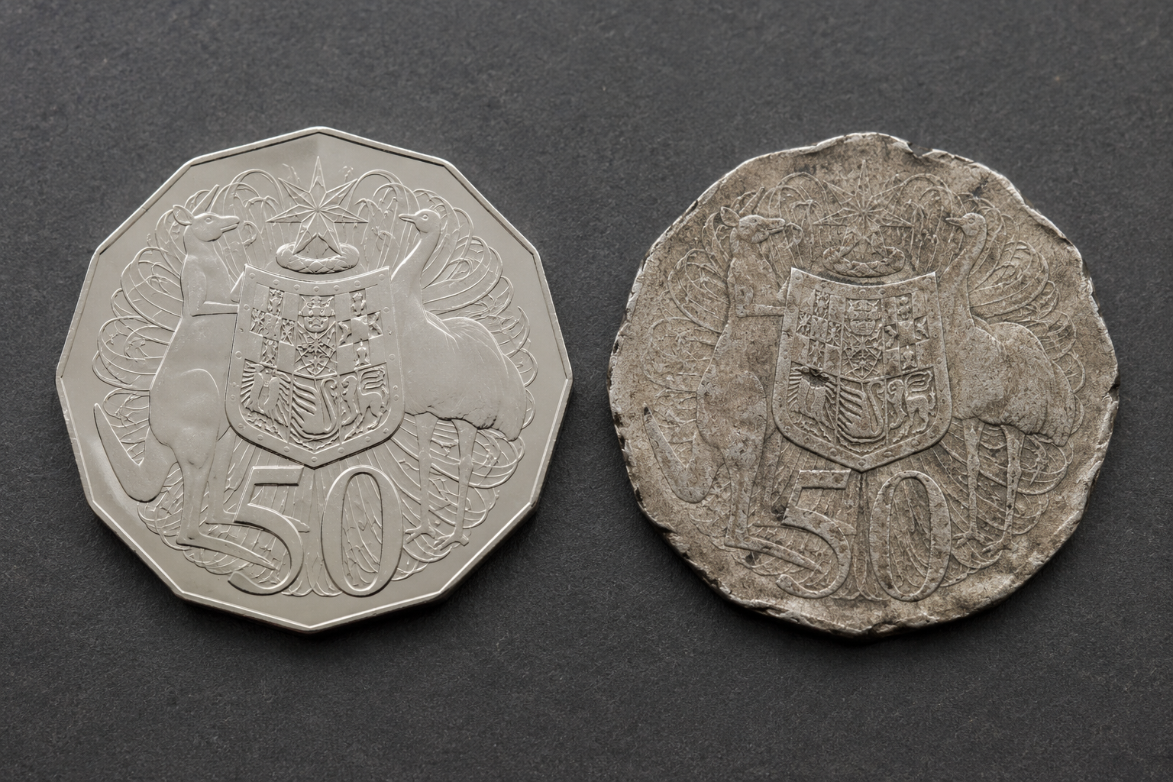
The Three Coins

Slide 17
As stated, Real Love always costs you something
Why is money valuable?
Because someone absorbs the cost.
A shiny coin fresh from the mint has never been through circulation.
But a worn coin?
That coin has bumped into thousands of other coins.
Handled. Scratched. Slightly Bent. Dented. Dropped. Lost and found.
Yet it still has the same value!

Slide 18
Christian community is like that
If you stay close to people long enough, there will be friction.
Churches are full of broken sinful people. That includes you and me! (“Stuck in Traffic”)
But mature love does not throw people away because of scratches and dents.

Slide 19
👉 Love is easy at a distance.
Love is tested up close.
👉 Friction is not proof love failed.
It is proof people are involved.

Slide 20
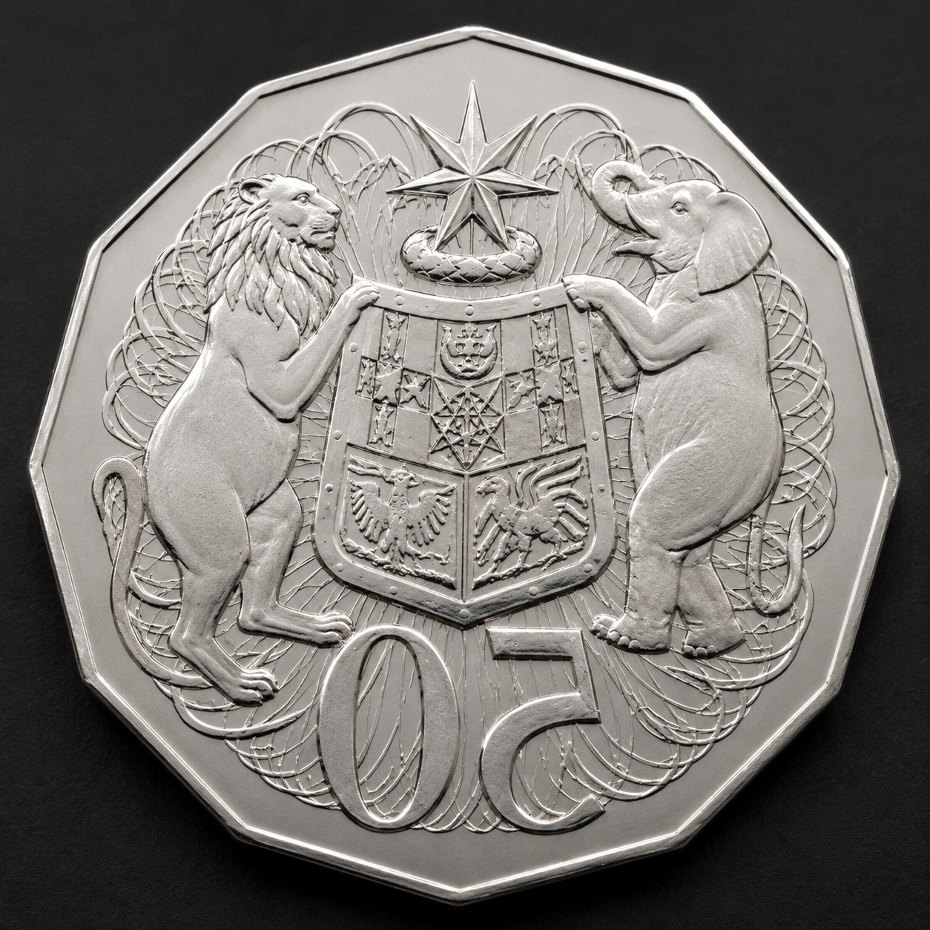

Slide 21
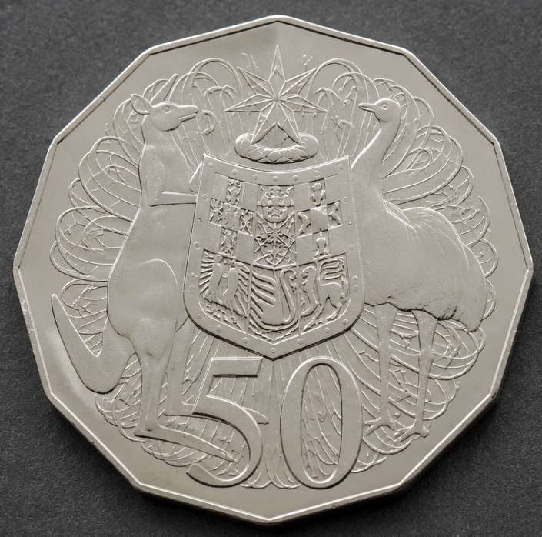

Slide 22
Two real coins… and one counterfeit.
Some relationships look like love
on the outside…
🙂 Smiling outwardly
😠 Bitter inwardly
🤝 Polite publicly
🗣 Gossip privately
🕊 Avoiding conflict
❄ Building distance
👉 Fake peace is not real peace.
Real love forgives honestly.

Slide 23
The Danger
Unresolved Offence Becomes Poison
Small offences become:
Bitterness
Distance
Coldness
Suspicion
Gossip
Division
Many churches do not explode overnight.
They slowly freeze.
“Mature love deals with wounds —
it does not hide them.”

Slide 24
Forgiveness, Reconciliation & Trust
COMMAND: Forgiveness - releases revenge, gives grace, & it hands judgment to God.
DESIRED: Reconciliation - requires truth, repentance, and safety
EARNED: Trust - rebuilds over time
Some relationships become healthy again.
Some require distance, boundaries,
or leadership involvement.
(Home Groups can dig into this more if they want to.)

Slide 25
What Mature Love Does
Love Absorbs Cost
Forgiveness always costs someone.
Jesus absorbed OUR debt.
Now we are called to:
Absorb offence
Release bitterness
Refuse scorekeeping
👉 “Love keeps no record of wrongs.”
(1 Corinthians 13)

Slide 26
Keeping it Real: Some People Are Hard To Love
Some are immature, regardless of their actual age
Some are wounded
Some are exhausting
Some repeatedly fail (As I do! I’m just better at hiding it.)
And yet…
God has had to “bear with” us too.
👉 Humility changes everything.

Slide 27
Scratch or Wound? (This is NOT two sides of a coin!)
Some things are:
Scratches
Just irritating friction
Others are:
Wounds
(real sin/damage)
Both matter…
but they are handled differently.

Slide 28
Scratches (“Bear With One Another”)
These are usually:
personality friction
preferences
immaturity
misunderstandings
annoyances
style differences
These require:
Patience
Humility
Conversation
Perspective
Grace

Slide 29
Wounds (“Forgive / Confront / Protect”)
These involve:
real current sin
damage
abuse
betrayal
destruction
ongoing unrepentance
division
These require:
Truth
Repentance
Forgiveness
Sometimes boundaries
Sometimes leadership involvement

Slide 30
Very Important Distinctions
Not every irritation is abuse.
But not every wound is merely irritation either.
Disagreeing does not mean they Hate you!
Balance and wisdom are gained during our walk with God.
“Love covers many irritations… but love does not protect evil.”
“Some things require patience. Some things require repentance.”
Some poor Christians use the excuse of “Bear with one another” to silence the people they wound!

Slide 31
“Practical Wisdom”
How To Bear With One Another:
Slow down
Ask questions first
Assume less
Listen longer
Pray before reacting
Speak privately first (Matt 18)
Refuse gossip – (talking about or listening to)
👉 Most conflict grows in the dark.

Slide 32
Diagnostic Questions
Who am I still holding unforgiveness for?
Who do I avoid?
Whose name changes my attitude immediately?
What offence am I replaying?
Have I asked God to forgive me of more than this?

Slide 33
Call to Action This Week
Pray for one person you struggle with;
Refuse gossip or scorekeeping;
Start one hard conversation gently;
Release one offence to God.
And:
Who will you share this with
that was not here today?
Who will ask you if you did it?

Slide 34
Conclusion
Mature love:
Stays soft
Tells the truth
Lets go of bitterness
Keeps showing up
👉 “Bear with one another… forgive one another… and above all these put on love.”
Love stays.
Love releases.
Love heals.

Slide 35
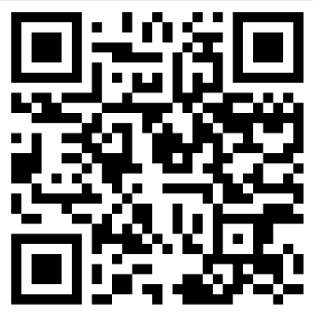
🎯 Prayer:
“Lord, teach us to love each other like You loved us.”
Today’s Message can be found at
reboot.meetgodathome.com

